Slide 1
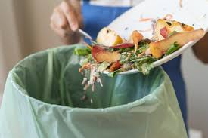
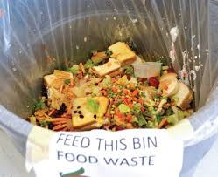
AI-Based Smart Food Waste Management System
A Smart Solution to Reduce Food Waste Using Artificial Intelligence
Presented by: Pradeepa J
Department: BE CSE (AIML)__________
College :Rathinam Technical Campus
1

Slide 2
Introduction
• Food waste is a major problem in homes, hotels, restaurants and institutions.
• Excess food is often prepared because demand is difficult to predict.
• Wasted food causes economic loss and environmental problems.
• AI can analyze consumption patterns and predict future food requirements.
• This system aims to make food management smarter and more sustainable.
2

Slide 3
Problem Statement
• Inaccurate demand estimation leads to excess food preparation.
• Expired and unused food is often discarded.
• Manual tracking of food waste is difficult and time-consuming.
• Kitchens need better information about consumption patterns.
Goal: Reduce food waste using AI-based prediction and smart monitoring.
3

Slide 4
Objectives
• Predict the required quantity of food using AI.
• Monitor food consumption and waste.
• Identify frequently wasted food items.
• Reduce unnecessary food preparation.
• Provide alerts for excess or near-expiry food.
• Improve resource utilization and sustainability.
4

Slide 5
Proposed System
The proposed system collects food-related data and uses AI to make smart decisions.
Food Data → AI Analysis → Demand Prediction → Food Preparation → Waste Monitoring → Smart Suggestions
• Historical consumption data is analyzed.
• AI predicts future food requirements.
• Waste data is recorded and used for better future planning.
5

Slide 6
Technologies Used
• Artificial Intelligence / Machine Learning – Demand prediction
• Data Analytics – Consumption and waste analysis
• Computer Vision – Food and waste identification
• Cloud Database – Store food and consumption data
• Web / Mobile Application – Alerts and reports
• IoT Sensors – Monitor smart waste bins
6

Slide 7
System Workflow
Food Consumption Data
↓
Data Collection
↓
Data Processing
↓
AI / ML Prediction
↓
Demand Estimation
↓
Food Preparation
↓
Waste Monitoring
↓
Reports & Suggestions
7

Slide 8
Key Features
• AI-based food demand prediction
• Smart food inventory tracking
• Expiry-date alerts
• Food waste monitoring
• Waste pattern analysis
• Smart recommendations
• Administrator dashboard
• Daily / weekly / monthly waste reports
8

Slide 9
Benefits & Impact
Benefits:
• Reduces food wastage and saves money.
• Improves inventory management.
• Helps kitchens prepare the right quantity.
• Reduces manual monitoring.
Environmental Impact:
• Less food sent to landfills.
• Reduced resource wastage.
• Supports sustainable food management.
9

Slide 10
Conclusion
• AI can play an important role in reducing food waste.
• The system predicts demand and monitors waste efficiently.
• Smart alerts and recommendations help prevent unnecessary disposal.
• It can be used in restaurants, hotels, college canteens, hospitals and households.
SAVE FOOD • REDUCE WASTE • BUILD A SUSTAINABLE FUTURE
Thank You!
10

